Slide 1
Non-determinism and bidirectional model transformations
Alfonso Pierantonio

Slide 2
In spite of its relevance, bidirectionality has rarely produced anticipated benefits.

Slide 3
In spite of its relevance, bidirectionality has rarely produced anticipated benefits.
Why?

Slide 4
There have been several works analyzing semantic issues and idiosyncrasies of bidirectional model transformations

Slide 5
«The developer needs full control of what the transformation does. [...] We claim that determinism is necessary in order to ensure, first, that developers will find tool behavior predictable, and second, that organisations will not be unacceptably “locked in” to the tool they first use.»
P. Stevens. Bidirectional model transformations in QVT: semantic issues and open questions. SOSYM, 8, 2009.

Slide 6
Model Transformations
A model transformation is an automatable way of ensuring that a family of models is consistent, in a precise sense which the software engineer can define.
The aim of using a model transformation is to save effort and reduce errors by automating the building and modification of models where possible.

Slide 7
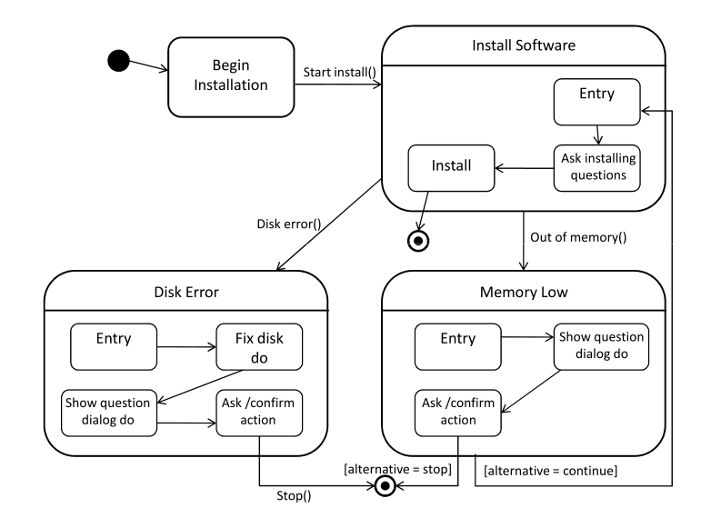
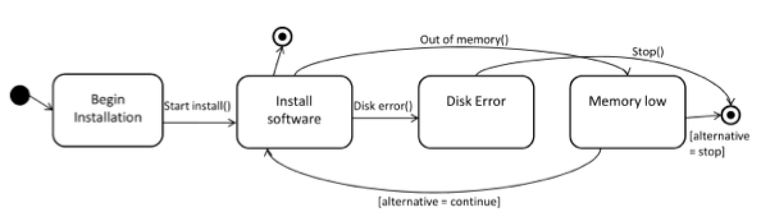
Model Transformations
A model transformation is an automatable way of ensuring that a family of models is consistent, in a precise sense which the software engineer can define.
The aim of using a model transformation is to save effort and reduce errors by automating the building and modification of models where possible.

Slide 8

Model Transformations
A model transformation is an automatable way of ensuring that a family of models is consistent, in a precise sense which the software engineer can define.
The aim of using a model transformation is to save effort and reduce errors by automating the building and modification of models where possible.
Consistent in a precise way!
It comprises plenty of different scenarios and mechanisms. Even more important: how ?

Slide 9
Bidirectionality
Bidirectionality is necessary whenever people are working on more than one model and the models must be kept consistent.

Slide 10
Bidirectionality
Bidirectionality is necessary whenever people are working on more than one model and the models must be kept consistent.

Slide 11

A system might need to be described according to multiple views

Slide 12
Architect’s view
Landlord’s view
Renter’s view
Interior designer’s view
…
Carpenter’s view
Plumber’s view
Electrician’s view

Slide 13
Bidirectionality
The relevance of bidirectionality has been advocated already in 2005 by OMG’s QVT standard, in particular the QVT Relations (QVT-R) language.
Current approaches include also Triple Graph Grammars (TGGs), SyncATL, JTL, and GRoundTram.

Slide 14
Bidirectionality
The relevance of bidirectionality has been advocated already in 2005 by OMG’s QVT standard, in particular the QVT Relations (QVT-R) language.
Current approaches include also Triple Graph Grammars (TGGs), SyncATL, JTL, and GRoundTram.
The QVT standard [1] is somewhat ambivalent about whether it intends all bidirectional QVT transformations to be bijective.
[1] OMG. MOF2.0 Query/View/Transformation (QVT) Adopted Specification. OMG document ptc/05-11-01, available from http://www.omg.org (2005)

Slide 15
Let try to sort things out.

Slide 16
Transformations
Software lifecycle methodologies have traditionally been making efforts to automate the production of concrete models from abstract ones or even to keep the different system models synchronized
M1
M2
horizontal
transformations
vertical
transformations
M1’

Slide 17
Vertical vs Horizontal
horizontal transformations
Consistency
management
A1
A2
Synchronization
A1
A2
vertical transformations
Abstraction
A1
A1
Forward engineering:
Generation
Reverse engineering:
Model injection/extraction
B1
B1

Slide 18
Consistency vs Synchronization
These two major model management mechanisms are typically realized by means of (unidirectional and bidirectional) transformations

Slide 19
Consistency vs Synchronization
These two major model management mechanisms are typically realized by means of (unidirectional and bidirectional) transformations
Consistency management is a many-to-many relational mechanism
Synchronization is a deterministic mechanism, most of the time fully automated
Consistency
management
A1
A2
Synchronization
A1
A2

Slide 20
Consistency vs Synchronization
These two major model management mechanisms are typically realized by means of (unidirectional and bidirectional) transformations
Despite these are well established techniques there is still some confusion and the latter is often used to explain or in place of the former
Synchronization ⊆ Consistency

Slide 21
Bidirectionality
The relevance of bidirectionality has been advocated already in 2005 by OMG’s QVT standard, in particular the QVT Relations (QVT-R) language.
Current approaches include also Triple Graph Grammars (TGGs), SyncATL, JTL, and GRoundTram.
The QVT standard [1] is somewhat ambivalent about whether it intends all bidirectional QVT transformations to be bijective.
[1] OMG. MOF2.0 Query/View/Transformation (QVT) Adopted Specification. OMG document ptc/05-11-01, available from http://www.omg.org (2005)

Slide 22
Consistency vs Synchronization
These two major model management mechanisms are typically realized by means of (unidirectional and bidirectional) transformations
Despite these are well established techniques there is still some confusion and the latter is often used to explain or in place of the former
Synchronization ⊆ Consistency
How bidirectionality fits in this picture ?

Slide 23
Consistency vs Synchronization
Synchronization is deterministic but not necessarily bijective
M₀
M₀ represents the synchronization (sub-model) between M₁ and M₂
M₂
M₁

Slide 24
Consistency vs Synchronization
Consider the bookmarks synchronization between different browsers (eg. Chrome, Safari, etc)
Besides the obviously shared information, each browser may have specific metadata which are not present in the others

Slide 25
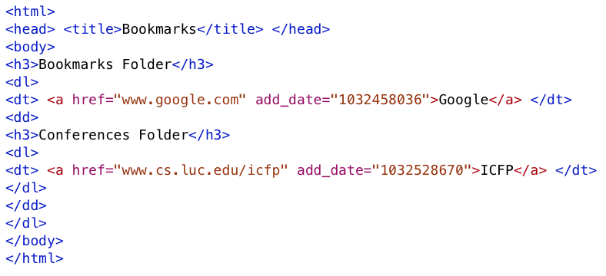
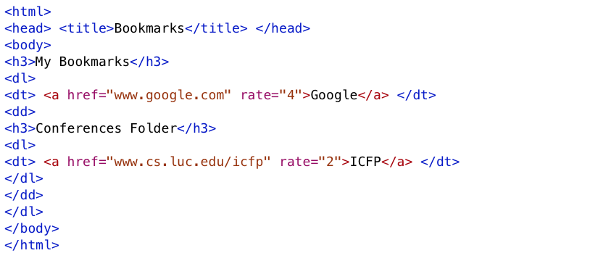
The highlighted elements are not shared among the two “models”
any change on these elements won’t be propagated
only changes on the “isomorphic” part must be propagated

Slide 26
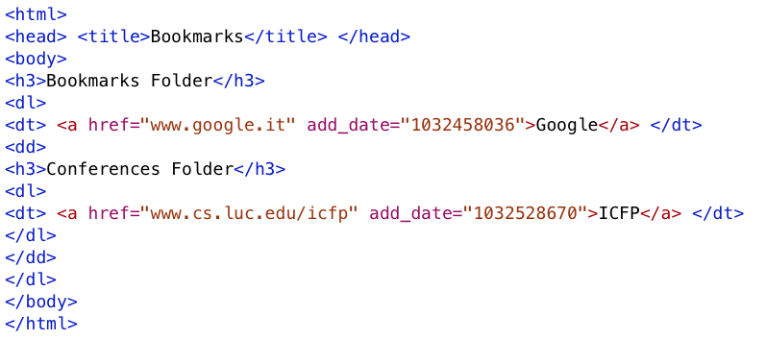
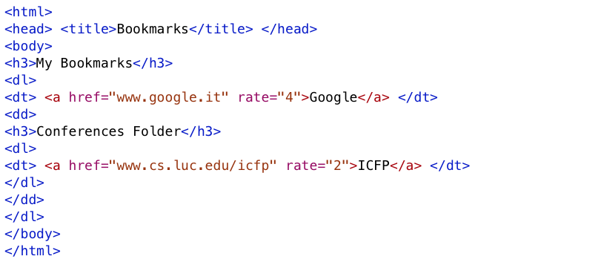
The highlighted elements are not shared among the two “models”
any change on these elements won’t be propagated
only changes on the “isomorphic” part must be propagated

Slide 27
Consistency vs Synchronization
Synchronization is deterministic but not necessarily bijective
Consistency Management
Synchronization
Bijective Synchronization

Slide 28
«The developer needs full control of what the transformation does. [...] We claim that determinism is necessary in order to ensure, first, that developers will find tool behavior predictable, and second, that organisations will not be unacceptably “locked in” to the tool they first use.»
P. Stevens. Bidirectional model transformations in QVT: semantic issues and open questions. SOSYM, 8, 2009.

Slide 29
Non-bijectivity
Most examples of bidirectional transformations are non-bijective, therefore there may be multiple ways to transform two models into a consistent state, introducing uncertainty and non-determinism.

Slide 30
Non-bijectivity
Most examples of bidirectional transformations are not bijective, therefore there may be multiple ways to transform two models into a consistent state, introducing uncertainty and non-determinism.
?

Slide 31
Opaque semantics of bidirectionality
Existing bidirectional languages translate a non-deterministic specification into an actual bidirectional transformation procedure.

Slide 32
Opaque semantics of bidirectionality
Existing bidirectional languages translate a non-deterministic specification into an actual bidirectional transformation procedure.
Consistency is enforced by imposing a specific «update policy» determined by foreign and unknown factors, ie. language implementation, heuristics, and rule order.

Slide 33
Opaque semantics of bidirectionality
Existing bidirectional languages translate a non-deterministic specification into an actual bidirectional transformation procedure.
Consistency is enforced by imposing a specific «update policy» determined by foreign and unknown factors, eg. language implementation, heuristics, and rule order.
As a consequence, result is unpredictable and developers have little or no control on the «update policy».

Slide 34
Solution
Developers must have full control via a clear semantics in order to
Managing the uncertainty: all admissible solutions must be generated at once letting the designer choose the desired one
Define the update policy: an intentional (and general) «update policy» is adopted and implemented at design-time (cfr. [1])
[1] Zan Tao, Hugo Pacheco, and Zhenjiang Hu. "Writing bidirectional model transformations as intentional updates." Companion Proceedings of the 36th International Conference on Software Engineering. ACM, 2014.

Slide 35
Solution
It is not always possible to define the update policy because the available information at design-time is not enough for defining the update policy
The decision must then be deferred to the modeler who is running the transformation by letting her traverse the complete solution space

Slide 36
Non-deterministic languages
Over the last yeast, new languages/semantics have been proposed
Janus Transformation Language (JTL)
Alloy-based Semantics for QVT-R
They are able to produce more than one result.

Slide 37
Janus Transformation Language (JTL)
JTL has formal semantics based on Answer Set Programming (ASP) and therefore can be considered a constraint-based approach.
ASP is a form of logic programming with non-monotonic reasoning related to SAT. Several solvers are available, eg. DLV.
JTL is embedded in a framework available on the Eclipse platform and can be applied to Ecore metamodels

Slide 38
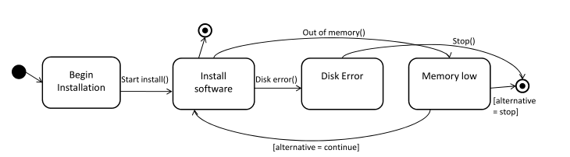
source
target
T
Non-hierarchical state machine obtained by flattening the source model
Manual Changes
Hierarchical State Machine

Slide 39
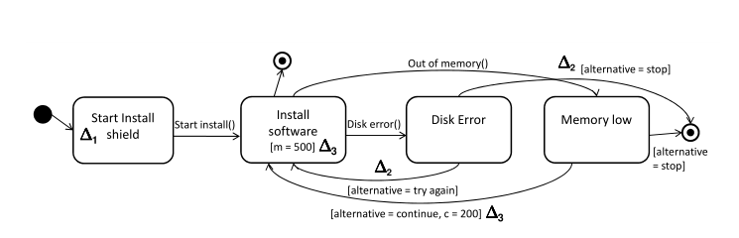
source
target
T
The designer performs some manual changes on the generated model
Manual Changes

Slide 40
Specifying transformation with JTL
Fragment of the HSM2NHSM transformation specified in JTL
transformation hsm2nhsm(source : HSM, target : NHSM) {
top relation StateMachine2StateMachine {
enforce domain source sSM : HSM::StateMachine;
enforce domain target tSM : NHSM::StateMachine;
}
top relation State2State {
enforce domain source sourceState : HSM::State;
enforce domain target targetState : NHSM::State;
when {
sourceState.owningCompositeState.oclIsUndefined();
}
}
top relation CompositeState2State {
enforce domain source sourceState : HSM::CompositeState;
enforce domain target targetState : NHSM::State;
}
}

Slide 41
Specifying transformation with JTL
It transforms hierarchical state machines into flat state machines and the other way round.
Fragment of the HSM2NHSM transformation specified in JTL
transformation hsm2nhsm(source : HSM, target : NHSM) {
top relation StateMachine2StateMachine {
enforce domain source sSM : HSM::StateMachine;
enforce domain target tSM : NHSM::StateMachine;
}
top relation State2State {
enforce domain source sourceState : HSM::State;
enforce domain target targetState : NHSM::State;
when {
sourceState.owningCompositeState.oclIsUndefined();
}
}
top relation CompositeState2State {
enforce domain source sourceState : HSM::CompositeState;
enforce domain target targetState : NHSM::State;
}
}

Slide 42
Specifying transformation with JTL
The forward transformation is clearly non-injective:
both «State» and «CompositeState» are mapped to the same target «State»
Fragment of the HSM2NHSM transformation specified in JTL
transformation hsm2nhsm(source : HSM, target : NHSM) {
top relation StateMachine2StateMachine {
enforce domain source sSM : HSM::StateMachine;
enforce domain target tSM : NHSM::StateMachine;
}
top relation State2State {
enforce domain source sourceState : HSM::State;
enforce domain target targetState : NHSM::State;
when {
sourceState.owningCompositeState.oclIsUndefined();
}
}
top relation CompositeState2State {
enforce domain source sourceState : HSM::CompositeState;
enforce domain target targetState : NHSM::State;
}
}

Slide 43
Specifying transformation with JTL
The forward transformation is clearly non-injective:
both «State» and «CompositeState» are mapped to the same target «State»
Fragment of the HSM2NHSM transformation specified in JTL
transformation hsm2nhsm(source : HSM, target : NHSM) {
top relation StateMachine2StateMachine {
enforce domain source sSM : HSM::StateMachine;
enforce domain target tSM : NHSM::StateMachine;
}
top relation State2State {
enforce domain source sourceState : HSM::State;
enforce domain target targetState : NHSM::State;
when {
sourceState.owningCompositeState.oclIsUndefined();
}
}
top relation CompositeState2State {
enforce domain source sourceState : HSM::CompositeState;
enforce domain target targetState : NHSM::State;
}
}

Slide 44
source
target
T
Problem
How to back propagate the manual changes on the target model towards the source models according to the knowledge encoded in T?
What about non-bijectivity?
Manual Changes

Slide 45
Change Propagation
The HSM and NHSM are non isomorphic metamodels, thus when back propagating changes on the target there are two alternatives
human-out-of-the-loop metamodel are artificially made isomorphic by programmatically selecting one and only one model
human-in-the-loop all the solutions are computed and the designer select one (or more) of them by inspection

Slide 46
Requirements for bidirectional transformations
A bidirectional transformation is a relation
R ⊆ M × N
characterized by the following directional mappings
R : M × N → N*
R : M × N → M*
where R takes a pair of models (m, n) and enforces the relation R. R does it in the opposite direction.
P. Stevens. Bidirectional model transformations in QVT: semantic issues and open questions. SOSYM, 8, 2009.

Slide 47
Requirements for bidirectional transformations
A bidirectional transformation is a relation
R ⊆ M × N
characterized by the following directional mappings
R : M × N → N*
R : M × N → M*
where R takes a pair of models (m, n) and enforces the relation R. R does it in the opposite direction.

Slide 48
Requirements for bidirectional transformations
Ippocraticness
If (m,n) are consistent, ie. (m,n) ∈ R ⊆ M × N then
R(m,n) = n and R(m,n) = m
Reachability
If R(m, n’) = m* ∈ M*, then R(m’, n’) = n’ ∈ N for each m’ ∈ m*
Choice preservation
R(m’,R(m’,n’)) = m’ for each m’ ∈ m*

Slide 49
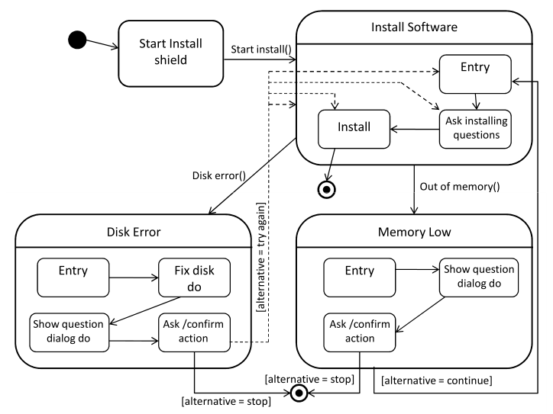
source
target
T
Modifications on the target are back propagated to the source which is consistently updated making use of tracing information
The designer performs some manual changes on the generated model
Manual Changes
T

Slide 50
Janus Transformation Language (JTL)
JTL programs can easily be refined with additional «constraints», for instance tracing information to perform round-tripping, and change propagation
JTL is embedded in a framework available on the Eclipse platform and can be applied to Ecore metamodels

Slide 51
JTL Engine
Source Metamodel MM_{S}
Target Metamodel MM_{T}
Model Transformation Specification
Source Metamodel Encoding
Target Metamodel Encoding
relations
constraints
Source Model Encoding
Execution Engine
Target Model(s) Encoding
bidirectional rules
Source Model
M_{S}
DLV System
Target Model
M_{T}

Slide 52
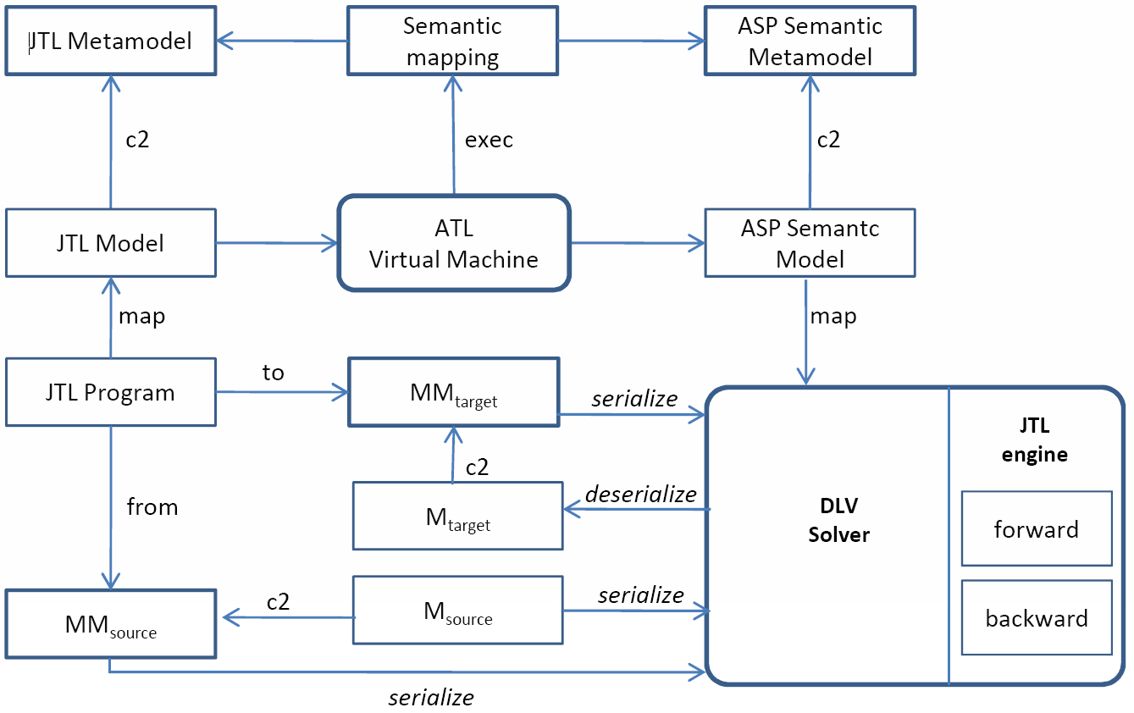
JTL Environment

Slide 53
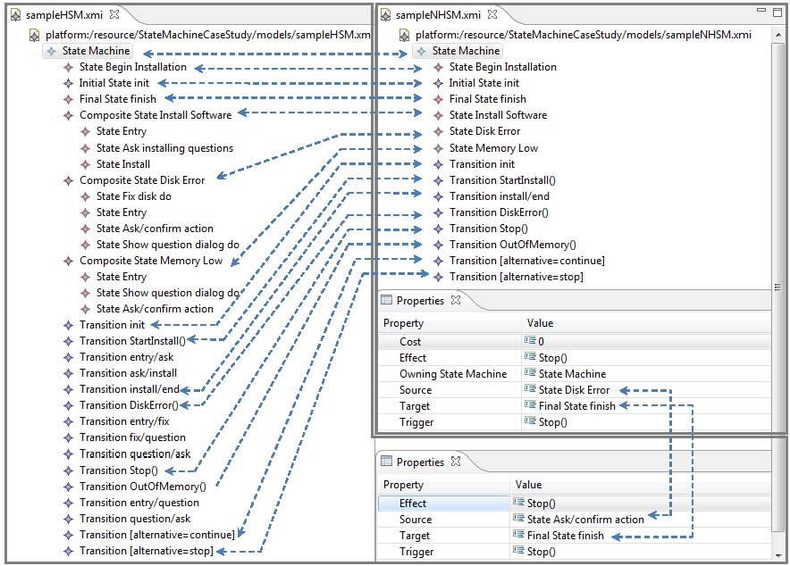
JTL in practice
Only super states are mapped. Sub states are not mapped in the flatten model: they are preserved by trace information
In the HSM model the transition Stop() starts from the substate Ask/confirm action, while in the NHSM model the target transition Stop() starts from the state Disk error

Slide 54
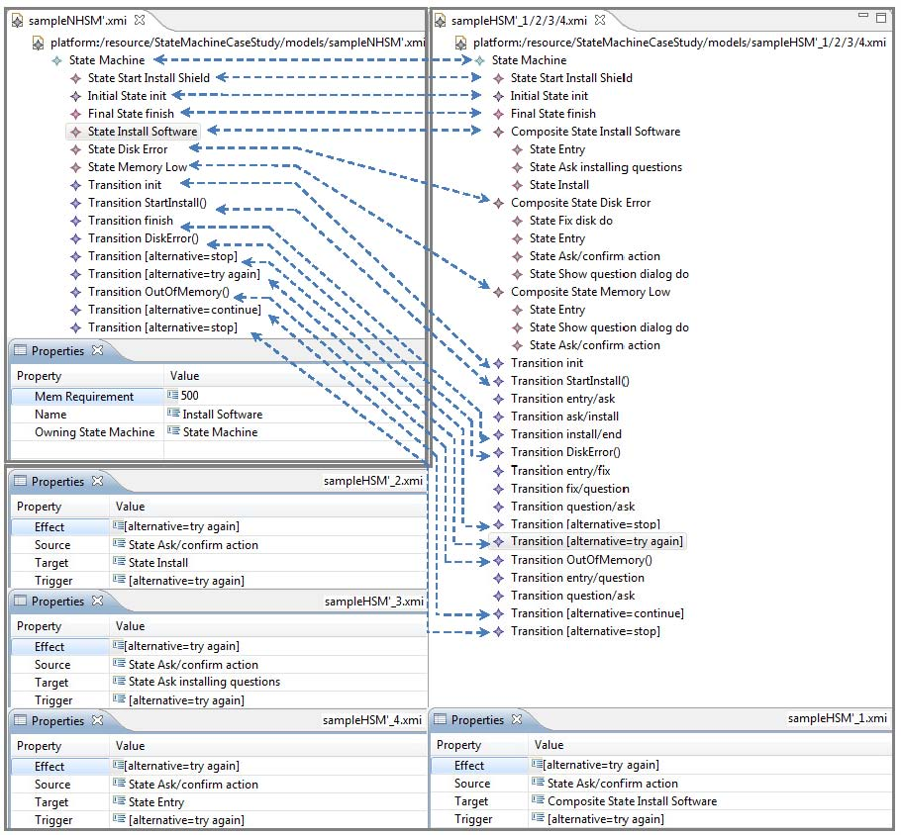
The target is manually modified by the following changes:
(1) renaming the initial state from Begin Installation to Start Install shield;
(2) adding the alternative try again to the state Disk Error to come back to Install software;
(3) changing the attributes related to memory requirements (m=500) in the state Install software and cost (c=200) of the transition from Memory low to Install software.
Several source model are generated. The change (1) has been propagated renaming the state to Start Install shield; the change (2) gives place to a non-bijective mapping and for this reason more
than one model is generated. The new transition can be equally targeted
to each one of the nested states; finally, the change
(3) is out of the domain of the transformation. In this case, the new values for memory
and cost are not propagated on the generated source models.
JTL in practice

Slide 55
Pragmatics
Dealing with medium-large size models poses many pragmatic problems due to the combinatorial explosion of the solution space.
Determining differences and commonalities among the models by traversing and inspecting the solution space is impractical.
An intensive representation of the solution space generated by a JTL transformation is sought to support traversal and inspection of the models throughout the solution space.

Slide 56
Uncertainty
Uncertainty is a consequence of non-determinism.
Our proposal is to represent the variability in the solution space by means of models with uncertainty in the sense of [2].
[2] Salay, R., Chechik, M., Horkoff, J., & Di Sandro, A. (2013). Managing requirements uncertainty with partial models. Requirements Engineering, 18(2), 107-128.

Slide 57
Uncertainty
The JTL semantics has been extended in order to factorize the solution space and generate a model with uncertainty instead of a set of models.
Uncertainty Metamodel
For any metamodel M an uncertainty metamodel U(M) can obtained by means of an automated transfromation
U: Ecore → Ecore

Slide 58
Uncertainty metamodel
metamodel-independence, the metamodel must be agnostic of the base metamodel.
model-based, a set of models representing different solution alternatives must be represented with a model with uncertainty.
minimality, a model with uncertainty should not contain any unnecessary information besides what actually needed.
interoperability, each model containing uncertainty must be applicable an unfolding operation, such that whenever applied to it returns all the correspondent concretizations models or the specific concretization selected by the designer.

Slide 59
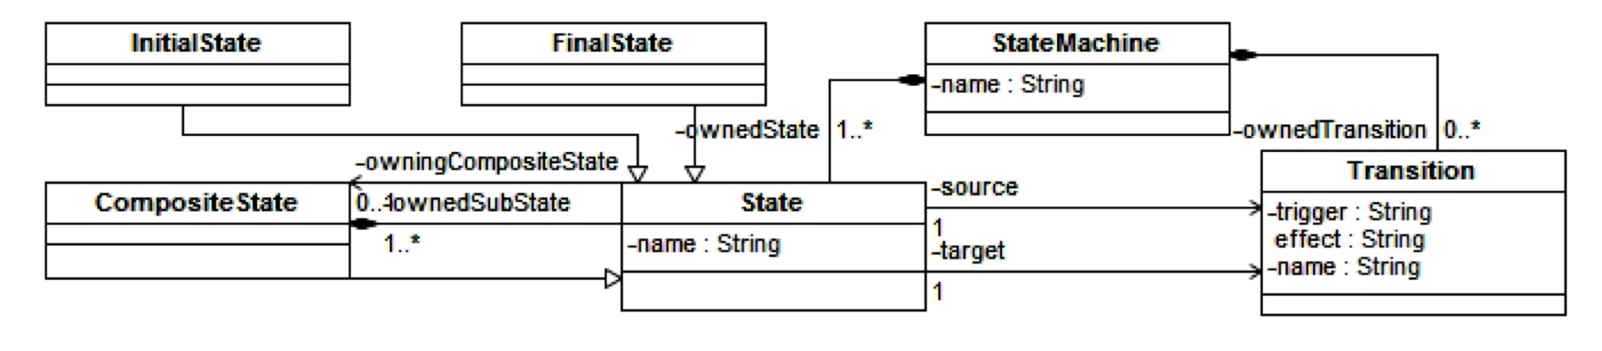
Example
HSM metamodel

Slide 60
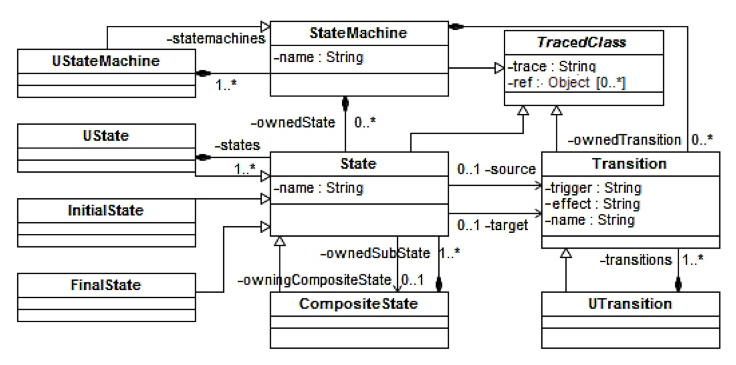
Example
The generated U(HSM) metamodel

Slide 61
Operators
Once the uncertainty metamodel U(M) is automatically defined starting from the base metamodel M, interoperability between the base and the uncertainty metamodels is necessary
Concretization operator: takes a model with uncertainty m* and returns the set of concretizations <m₁ … m_{n}>
Refinement operator: takes a model with uncertainty m* and a predicate p and returns the set of models m satisfying the predicate

Slide 62
Uncertainty and Bidirectionality
A bidirectional transformation is characterized by the following directional mappings
R_{u} : M × N → U(N) × Ocl
R_{u} : M × N → U(M) × Ocl
where U(N) and U(M) are the uncertainty metamodels automatically obtained from N and M.
If (m,n) is not in R ⊆ M × N then R_{u}(m,n) = (n,p_{N}) where n is a model with uncertainty in U(N) and p_{N} a predicate over N.

Slide 63
Uncertainty and Bidirectionality
If (m,n) is not in R ⊆ M × N then R_{u}(m,n) = (n,p_{N}) where n is a model with uncertainty in U(N) and p_{N} a predicate over N such that
concr(R_{u}(m,n’)) = m = R(m,n’)
for any n’ in refine(n,p_{N})

Slide 64
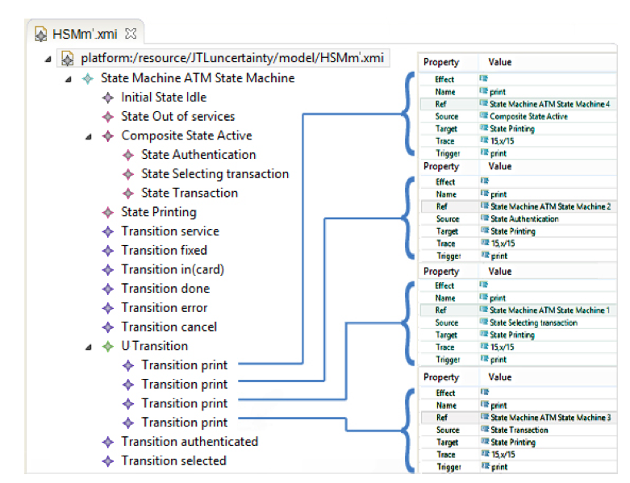
Example

Slide 65
Conclusion
The JTL semantics has been refined in order to be able to generate directly the model with uncertainty semantically corresponding to the complete solution space.
The approach is implemented on Eclipse/EMF.

Slide 66
In spite of its relevance, bidirectionality has rarely produced anticipated benefits
Why?

Slide 67
Too many languages have unpredictable behavior by addressing non-determinism in a opaque way
Requiring determinism is not always possible, nevertheless this has been fully accepted and enforced by the scientific community
Anthropologically computer scientists tend to think that transformation languages are niche Java specializations

Slide 68
Thank you!

